Slide 1
Week 2: Voluntary Disclosure
Prof. Zheng Wang
AC8900
Semester A 2026/2027

Slide 2
Homework: Why is voluntary disclosure not cheap talk?

Slide 3
The existence of proprietary cost makes voluntary disclosure credible:
  Gigler, F. 1994. Self-enforcing voluntary disclosures. Journal of Accounting Research 32 (2): 224-240.
    Proprietary costs are the friction that prevents full disclosure. In contrast, Gigler (1994) assumes that a manager wants to overstate profitability to the capital market in the absence of verification. But the manager would like to convince its competitor that demand is low. Such a trade-off will make voluntary disclosure believable
Signaling managerial ability:
  Lee, S., Matsunaga, S. R., & Park, C. W. (2012). Management forecast accuracy and CEO turnover. The Accounting Review, 87(6), 2095-2122.
Confirmation of mandatory disclosure
  Ball, R., Jayaraman, S., & Shivakumar, L. (2012). Audited financial reporting and voluntary disclosure as complements: A test of the confirmation hypothesis. Journal of accounting and economics, 53(1-2), 136-166.
Disaggregation of earnings forecasts;
  Hirst, D. E., Koonce, L., & Venkataraman, S. (2007). How disaggregation enhances the credibility of management earnings forecasts. Journal of Accounting Research, 45(4), 811-837.

Slide 4
Hirst, D. E., Koonce, L., & Venkataraman, S. (2007). How disaggregation enhances the credibility of management earnings forecasts (JAR)
Disaggregated forecasts include an earnings forecast as well as forecasts of other key line items comprising that earnings forecast.
We experimentally test whether a characteristic of a management earnings forecast—namely, whether it is disaggregated—can affect its credibility.
We also test whether disaggregation moderates the relation between managerial incentives and forecast credibility.
Our results indicate that disaggregated forecasts are judged to be more credible than aggregated ones and that disaggregation works to counteract the effect of high incentives

Slide 5
First, we maintain that disaggregating the earnings forecast provides a positive signal of the precision (or certainty) of management’s beliefs about the forecast (Ajinkya and Gift [1984], King, Pownall, and Waymire [1990]), leading to enhanced forecast credibility.
Second, we argue that disaggregating the earnings forecast provides additional clarity which, in turn, permits investors to more easily evaluate the quality of the forecast (Hutton, Miller, and Skinner [2003]).
Third, a disaggregated forecast reduces managers’ opportunities to achieve the forecast through earnings management (Kasznik [1999]).

Slide 6
Lee, S., Matsunaga, S. R., & Park, C. W. (2012). Management forecast accuracy and CEO turnover (TAR)
We investigate whether management forecast accuracy provides a signal regarding CEOs' ability to anticipate and respond to future events by examining the relation between management forecast errors and CEO turnover.
We find that the probability of CEO turnover is positively related to the magnitude of absolute forecast errors when firm performance is poor and that this positive relation holds for both positive and negative forecast errors.
We find that the positive relation between CEO turnover and the absolute forecast errors is concentrated in the sample of less entrenched CEOs.
Our findings indicate that boards of directors use management forecast accuracy as a signal of CEOs' managerial ability and that managers bear a cost for issuing inaccurate forecasts.

Slide 7
(Dis)incentives for Voluntary Disclosure

Slide 8
(Dis)incentives for Voluntary Disclosure
Capital Providers’ information demand: Managers carter to such demand for capital market benefits (see Healy and Palepu [2001], Core [2001], Hirst, Koonce, and Venkataraman [2008], and Leuz and Wysocki [2008] for reviews):
Better liquidity, lower cost of capital, and improved firm value
  IPO, SEOs, debt issuance
Stock-based compensation and corporate control contest
Career concern
Litigation
Proprietary cost
Other determinants: managerial style, managerial ability, peer effect
Cost benefit trade off
Notes:
Research suggests that there is significant demand from capital market participants for the disclosure of earnings forecasts by managers (see Healy and Palepu [2001], Core [2001], Hirst, Koonce, and Venkataraman [2008], and Leuz and Wysocki [2008] for reviews). This same research suggests that managers decide whether to issue forecasts based on their perceptions of the costs and benefits to the firm (e.g., higher liquidity and lower capital costs are weighed against proprietary and litigation costs) and to themselves (e.g., effects on reputation and stock compensation). Managers are more likely to issue forecasts when they expect growth (Core [2001]) or rising earnings (Miller [2002]), and have the ability to accurately predict earn- ings and meet or beat their forecasts (Hutton and Stocken [2009], Bhojraj, Libby, and Yang [2011]). Firms tend to cease issuing forecasts in the face of a sequence of bad quarters or when their forecast accuracy declines (Chen, Matsumoto, and Rajgopal [2011], Houston, Lev, and Tucker [2010]).

Slide 9
(Dis)incentives: Information Demand

Slide 10
Boone, A. L., & White, J. T. (2015). The effect of institutional ownership on firm transparency and information production. Journal of financial economics, 117(3), 508-533.
Abstract
We examine the effects of institutional ownership on firms׳ information and trading environments using the annual Russell 1000/2000 index reconstitution. Characteristics of firms near the index cutoffs are similar, except that firms in the top of the Russell 2000 have discontinuously higher proportional institutional ownership than firms in the bottom of the Russell 1000 primarily due to indexing and benchmarking strategies. We find that higher institutional ownership is associated with greater management disclosure, analyst following, and liquidity, resulting in lower information asymmetry. Overall, indexing institutions׳ predilection for lower information asymmetries facilitates information production, which enhances monitoring and decreases trading costs.

Slide 11
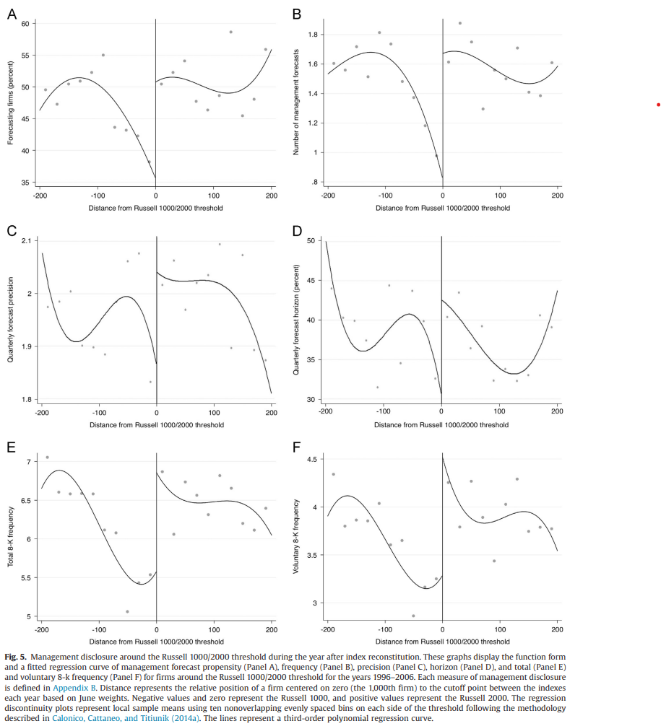

Slide 12
(Dis)incentives: Career Concern

Slide 13
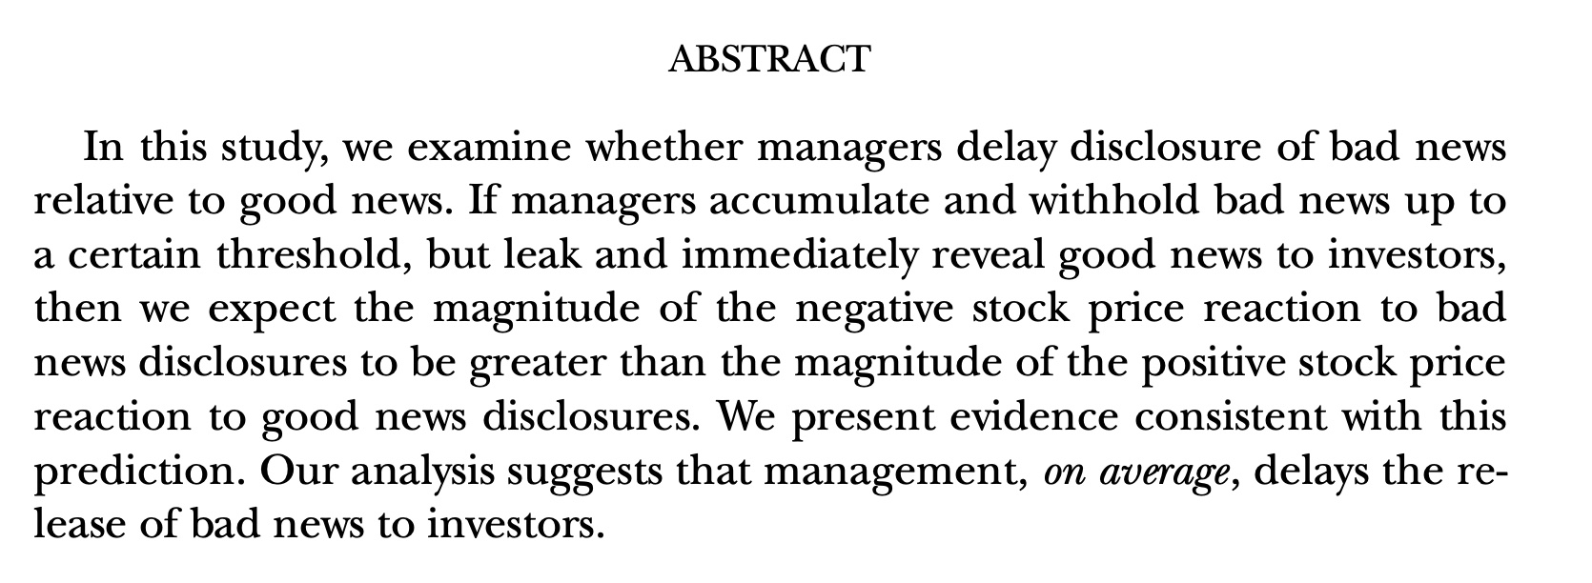
Kothari, S.P., Shu, S., Wysocki, P.D., 2009. Do managers with hold bad news? Journal of Accounting Research 47(1): 241–276.

Slide 14
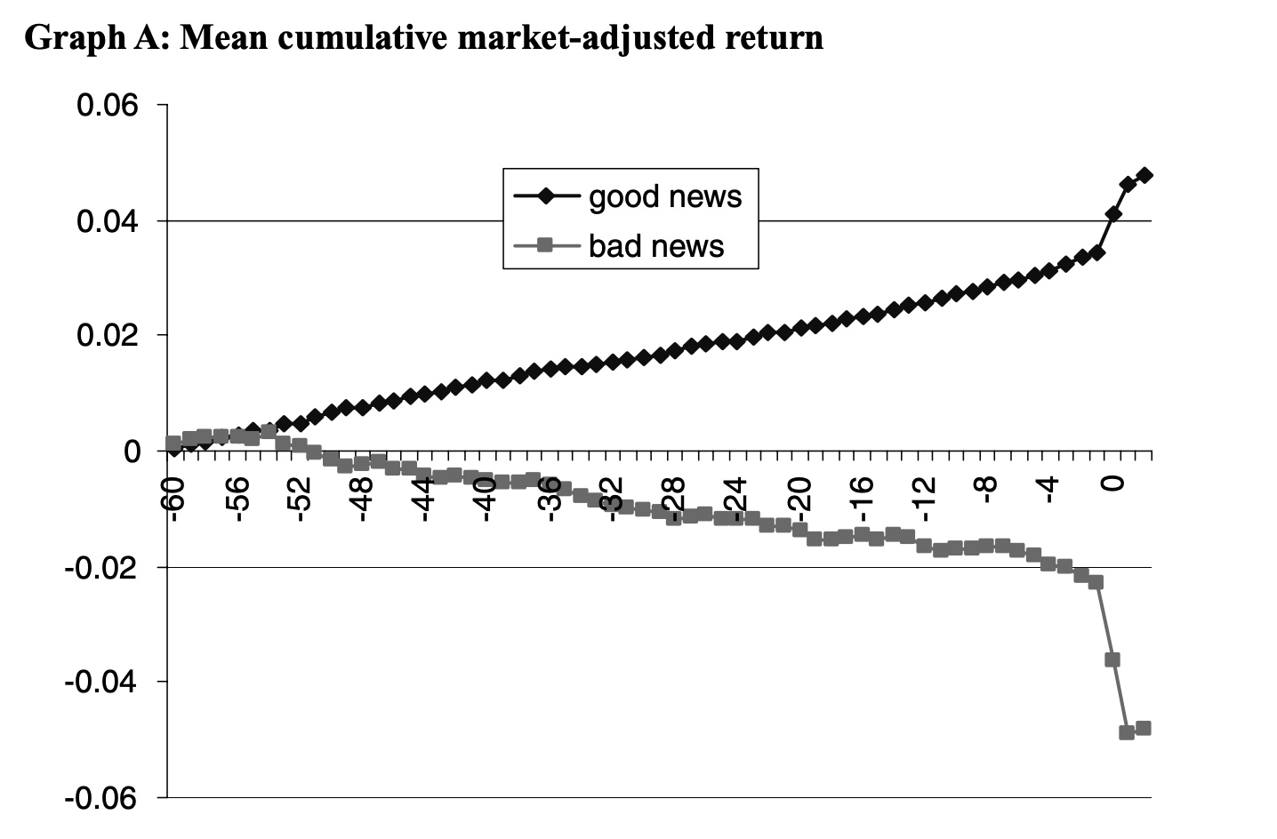

Slide 15
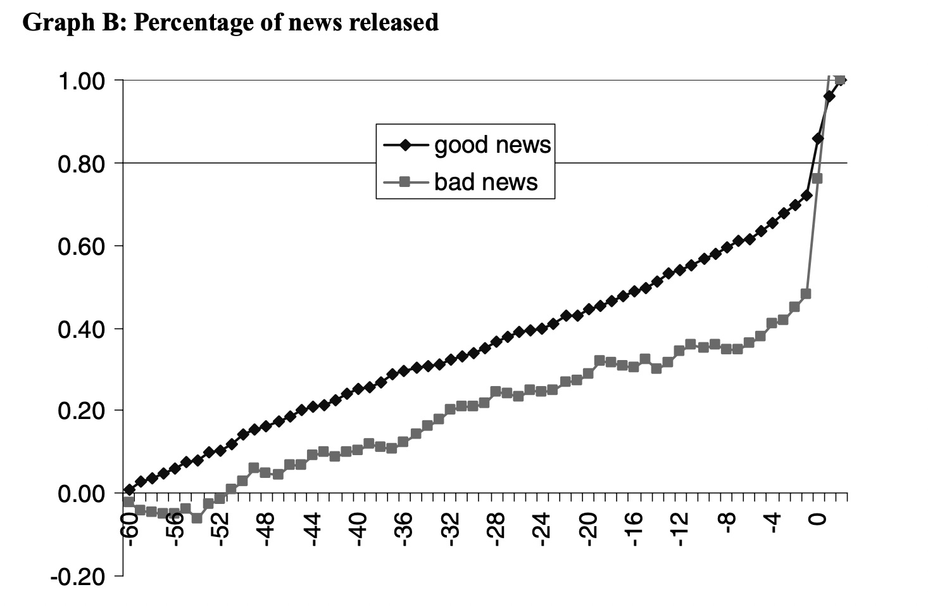

Slide 16
Dis(incentives): Litigation Risk

Slide 17
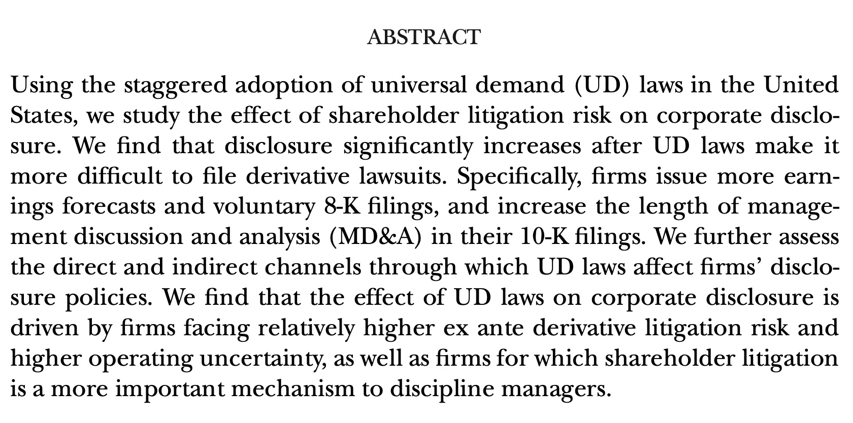
Bourveau, T., Y. Lou, and R. Wang. 2018. Shareholder litigation and corporate disclosure: evidence from derivative law suits. Journal of Accounting and Research 56 (3): 797-842.

Slide 18
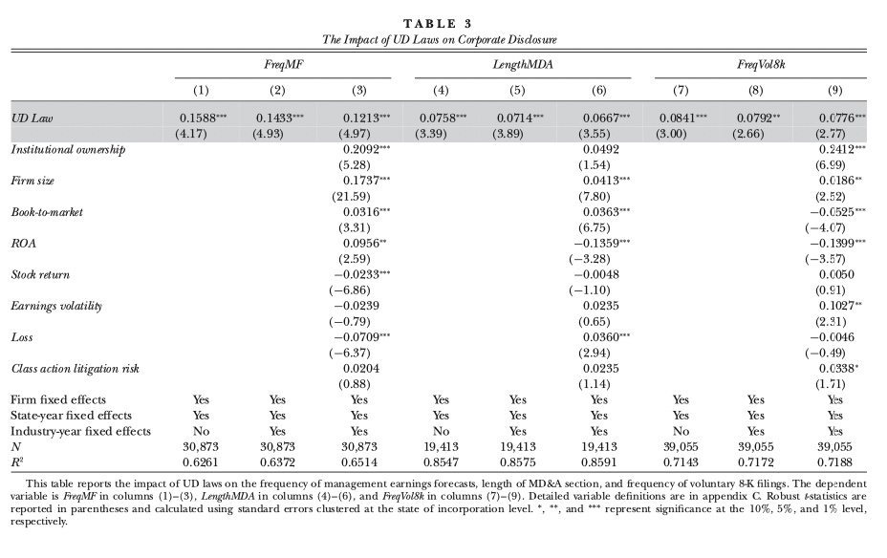

Slide 19
(Dis)incentive: Proprietary Cost

Slide 20
Ellis, J. A., Fee, C. E., & Thomas, S. E. (2012). Proprietary costs and the disclosure of information about customers. Journal of Accounting Research, 50(3), 685-727.
      Voluntary disclosure: customer information disclosures
      Benefits: the information of customers is crucial to investors,
        In assessing the risks inherent in a firm’s current and future revenues.
      Cost: Given that such disclosures to investors can also be observed by a firm’s current and potential rivals, these disclosures can aid rivals in competing with the disclosing firm.
      In deciding how much information about a firm’s customers to disclose, managers face a trade-off between the benefits of reducing information asymmetry with capital market participants and the costs of aiding rivals. (Wagenhofer [1990], Hayes and Lundholm [1996])

Slide 21
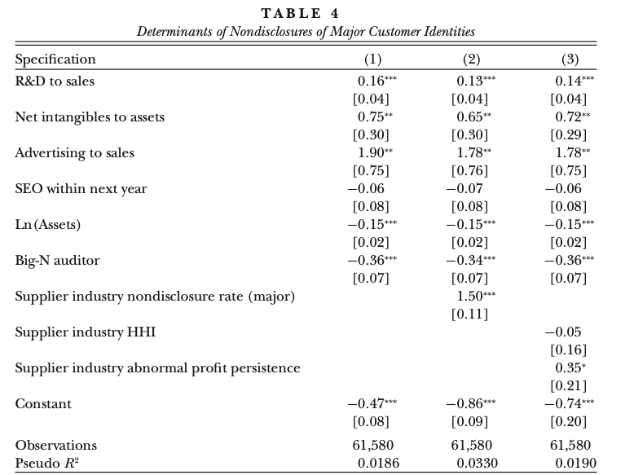

Slide 22
Kim, Y., Su, L., Wang, Z., & Wu, H. (2021). The effect of trade secrets law on stock price synchronicity: Evidence from the inevitable disclosure doctrine (TAR)
Inevitable Disclosure Doctrine (IDD) is a common law principle that prevents a ﬁrm’s employee who knows the ﬁrm’s trade secrets from working for its rivals. In states where the courts have recognized the IDD, a ﬁrm’s former workers can be prevented from working for its competitors if this would ‘‘inevitably’’ lead them to divulge the ﬁrm’s trade secrets to the competitors.
Prior to states’ recognition of the IDD, competitors could obtain proprietary information by directly hiring ﬁrms’ former employees who have access to the information. Thus, it is less costly for ﬁrms to disclose such information publicly for capital market beneﬁts. As the IDD lowers employee mobility and constrains competitors’ ability to obtain proprietary information by scoping from former employees, however, rival ﬁrms will rely more on a ﬁrm’s public disclosure to glean proprietary information and, in turn, ﬁrms have more proprietary information to safeguard from their rivals.

Slide 23
Kim, Y., Su, L., Wang, Z., & Wu, H. (2021). The effect of trade secrets law on stock price synchronicity: Evidence from the inevitable disclosure doctrine (TAR)
When the recognition of the IDD increases the proprietary cost of disclosure and leads to a decrease in proprietary information disclosures, information asymmetry increases. As a result, managers could resort to nonproprietary information disclosure to reduce the information asymmetry.
As the recognition of the IDD potentially has different effects on the disclosures of proprietary and nonproprietary information, we focus on stock price synchronicity to examine the net effect of the IDD on the production of ﬁrm-speciﬁc information.

Slide 24
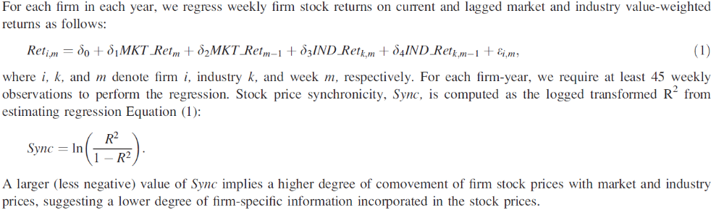
Kim, Y., Su, L., Wang, Z., & Wu, H. (2021). The effect of trade secrets law on stock price synchronicity: Evidence from the inevitable disclosure doctrine (TAR)

Slide 25
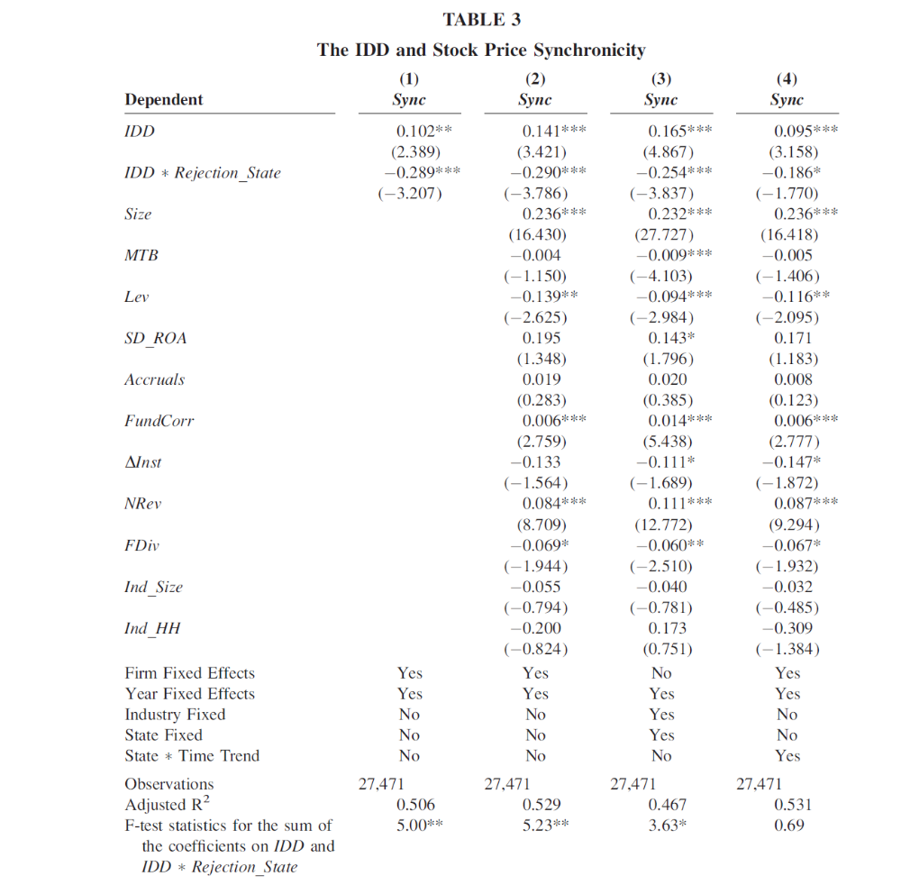

Slide 26
(Dis)incentives: Management Style and Ability

Slide 27
Bamber, L. S., Jiang, J., & Wang, I. Y. (2010). What’s my style? The influence of top managers on voluntary corporate financial disclosure (TAR)
We ﬁnd top executives exert unique and economically signiﬁcant inﬂuence (manager-speciﬁc ﬁxed effects) on their ﬁrms’ voluntary disclosures, incremental to known economic determinants of dis-closure, and ﬁrm- and time-speciﬁc effects.
Managers’ unique disclosure styles are associated with observable demographic characteristics of their personal backgrounds: managers promoted from ﬁnance, accounting, and legal career tracks, managers born before World War II, and those with military experience develop disclosure styles displaying certain conservative characteristics; and managers from ﬁnance and accounting and those with military experience favor more precise disclosure styles.
These plausible associations conﬁrm that our estimated manager-speciﬁc ﬁxed effects capture systematic long-lived differences in managers’ unique disclosure styles.

Slide 28
Li, F., Minnis, M., Nagar, V., & Rajan, M. (2014). Knowledge, compensation, and firm value: An empirical analysis of firm communication (JAR)
Knowledge is central to managing an organization, but its presence in employees is difficult to measure directly.
We hypothesize that external communication patterns reveal the location of knowledge within the management team.
Using a large database of firm conference call transcripts, we find that CEOs speak less in settings where they are likely to be relatively less knowledgeable.
CEOs who speak more are also paid more, and firms whose CEO pay is not commensurate with CEO speaking have a lower industry-adjusted Tobin׳s Q.
Communication thus appears to reveal knowledge.

Slide 29
How to do a “research project”
You need to have an idea
Formalize your idea as a research question: what do you want to know? Why should we care the answer?
What are the potential answers, why (expected)?
Collect data and design a testing method
Analyze results, robustness tests.
Conclusion: answer the question. What have we learned? Other related questions need further investigations.

Slide 30
(Self-) Assess Research Paper (Evans et al. CAR2015, Appendix)
Research Question (definitions, scope, causal vs. association)
Theory (literature review, logical consistency, specify mechanisms, tensions, conditioning effects, etc.)
Contribution
Research design (sample, measurement, identifications, alternative explanations)
Interpretations and conclusions (economic vs. statistical significance, reasonableness of the direction and magnitude, avoid over-claim)

Slide 31
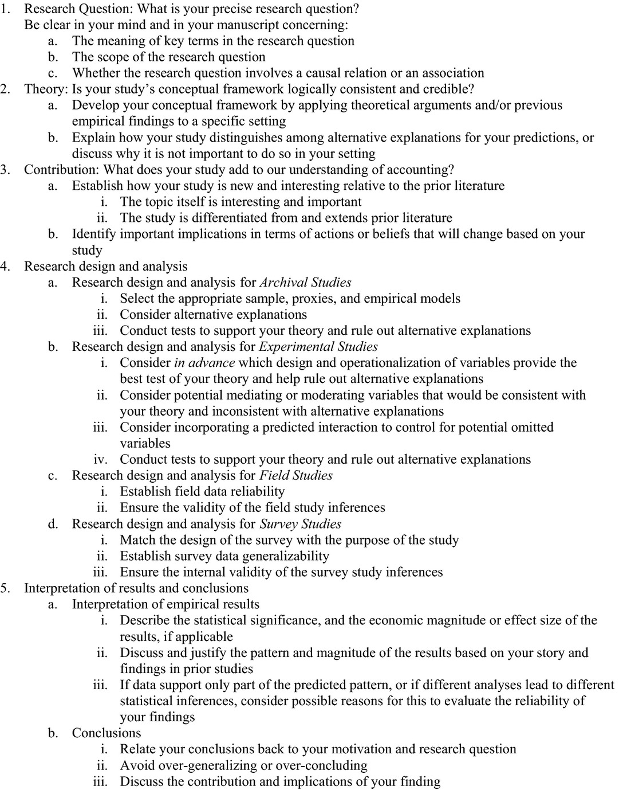

Slide 32
Languages and Management Forecasts around the World
Franco Wong
Yuyan Guan
Zheng Wang
Xiangang Xin

Slide 33
Motivation: Language Shapes Thoughts
Sapir-Whorf hypothesis (the principle of Linguistic relativity): thoughts are shaped by language (Whorf, 1956).
Linguistics and psychology research suggests that language influences speakers’ cognition of space, color, number, gender, causality, and relationship.
For example, Tarahumara speakers of Mexico do not distinguish “blue” and “green” in their language.
As another example, the Piraha in Brazil use “many” to describe quantities beyond two in their language.
A third example, Chinese speakers describe “uncle” in more specific ways than English speakers.
Uncle: 伯父、叔父、舅舅、姑夫、姨夫

Slide 34


A 2016 Movie: Arrival
The aliens offer their language to us on earth, a written language of complicated circular symbols.
Those who master it have their perception of time altered, and they can see the future

Slide 35
Motivation: Language Shapes Thoughts
From one specific perspective, languages shape speakers’ thoughts about “future”.
  Specifically, languages widely differ in how they force their speakers to grammatically mark future events, called “future time reference” (FTR) (Dahl 2000; Thieroff 2000).
For example, when talk about the weather,
English/French speakers say “Will it rain tomorrow?” (Strong-FTR)
Chinese/Dutch speakers say “Does it rain tomorrow?” (Week-FTR)
Strong-FTR language forces their speakers to habitually distinct between the present and future, making the future feels more distant; Week-FTR language shortens the psychological distance of the future to their speakers, making the future feel more close.

Slide 36
Motivation: Language Shapes Thoughts (Cont.)
Linguistics theory concludes that weak-FTR speakers are naturally more concerned about the future (Dahl 2000; Thieroff 2000).
  Applying this theory to individual behavior, Chen (2013, AER) shows that weak-FTR speakers foster future-oriented behavior such as saving more, retiring with more wealth, smoking less, etc.
We apply the linguistics theory to individual investors’ behavior.
  Investors who speak FTR languages are more future oriented/forward looking and have lower discount rate for future payoffs.

Slide 37
Motivation: FTR and Firm Disclosure
We further ask this question: When investors are more future-oriented, how would they influence firm disclosure?
  Valuation purpose: weak-FTR speakers: (a) discount future payoffs less than strong-FTR speakers because they perceive the future as closer, and (b) value future payoffs more because they hold less precise beliefs about the timing of future payoffs than do their strong-FTR counterparts.
  Monitoring purpose: investors in weak-FTR countries are expected to demand more management forecasts than their counterparts in strong-FTR countries to monitor managers and assess their ability to respond to future uncertainties. Since weak-FTR speakers view the future as more imminent, they care more about managers’ ability to anticipate and respond to future changes in firms’ economic environment.
Notes:
Because investors in weak-FTR countries perceive future earnings announced at the same point of time as more imminent and discount them to a lesser degree, the information about future earnings streams can cause a larger reaction from investors in weak-FTR countries than those in strong-FTR countries.
In other words, the information about future earnings is relatively more useful to investors in weak-FTR countries in terms of valuation. Thus, they are willing to expend greater efforts to acquire forward-looking information.
Trueman (1986) argues that management forecasts can serve as a public signal of such ability given the forward-looking nature of management forecasts. In order to issue credible forecasts of future earnings, managers need to have a good understanding of how changing business conditions affect the firm’s product demand and operations, as well as a strong ability to deal with uncertain events (Lee, Matsunaga and Park 2012). Prior studies show that the quality of management forecasts is related to managerial ability (Baik, Farber, and Lee 2011), CEO turnover (Lee et al. 2012), and the quality of corporate acquisition and capital expenditure decisions (Goodman, Neamtui, Shroff and White 2014).

Slide 38
Hypothesis 1
All else being equal, firms in countries with weak-FTR languages exhibit a higher propensity and frequency in issuing management earnings forecasts, compared to those in countries with strong-FTR languages.

Slide 39
Hypothesis 2
Investors in weak-FTR countries consider the same long-horizon future as more imminent than those in strong-FTR countries, they naturally want to know more about earnings to be announced in a longer horizon, compared to their counterparts in strong-FTR countries. Meanwhile, investors in weak-FTR countries are also more concerned about managers’ ability to deal with uncertainties in the longer horizon compared to those in strong-FTR countries.
All else being equal, forecasting firms in countries with weak-FTR languages issue more long-horizon management earnings forecasts than their counterparts in countries with strong-FTR languages.

Slide 40
Data
We collect international firm-level management forecast data for the period of 2004-2014 from Standard & Poor’s Capital IQ.
We closely follow Chen (2013) and collect the data of dominant language in each country and the classification of each language as weak- or strong-FTR language.
We collect the data of country-level variables from various sources.
Control variables are from Compustat Global, IBES, and FactSet.
Our final sample consists of 139,825 firm-year observations from 36 countries.

Slide 41
Main Variables
MF_PROP (Management Forecast Propensity): an indicator variable equal to 1 if a firm issues at least one management forecast in a given year and 0 otherwise.
MF_FREQ (Management Forecast Frequency): total number of management forecasts issued by a firm in a given year.
MF_LongHorizon: Long-horizon forecasts, measured as the number of annual forecasts which are issued before the beginning of fourth quarter by a firm in a given year.
Weak_FTR: an indicator variable equals one if the dominant language or office language in one country is weak-FTR language, and zero otherwise.

Slide 42
Baseline Regression
Baseline Regression
  Based on our hypothesis, we expect to find a positive effect of Weak FTR on MF.
  The controls variables are drawn on the extant literature.
  We use industry fixed effects to capture firms’ litigation risk and industry level characteristics.
  We control for year fixed effect.
  We run Logit regression for MF_PROP and ordered Logit regression for MF_FREQ.

Slide 43
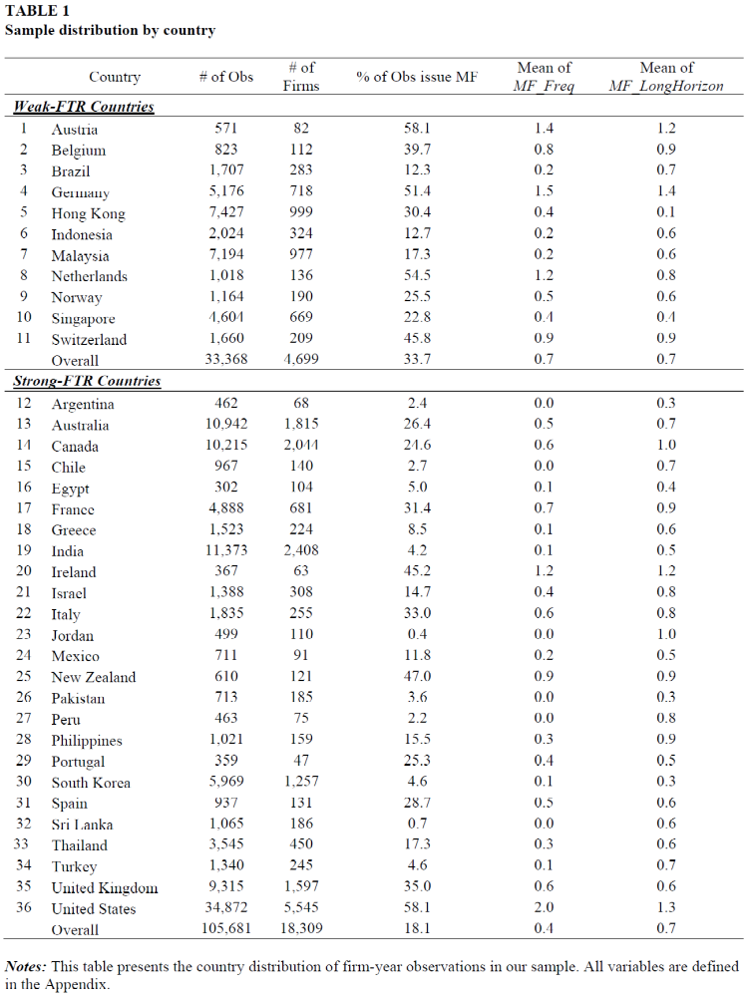

Slide 44
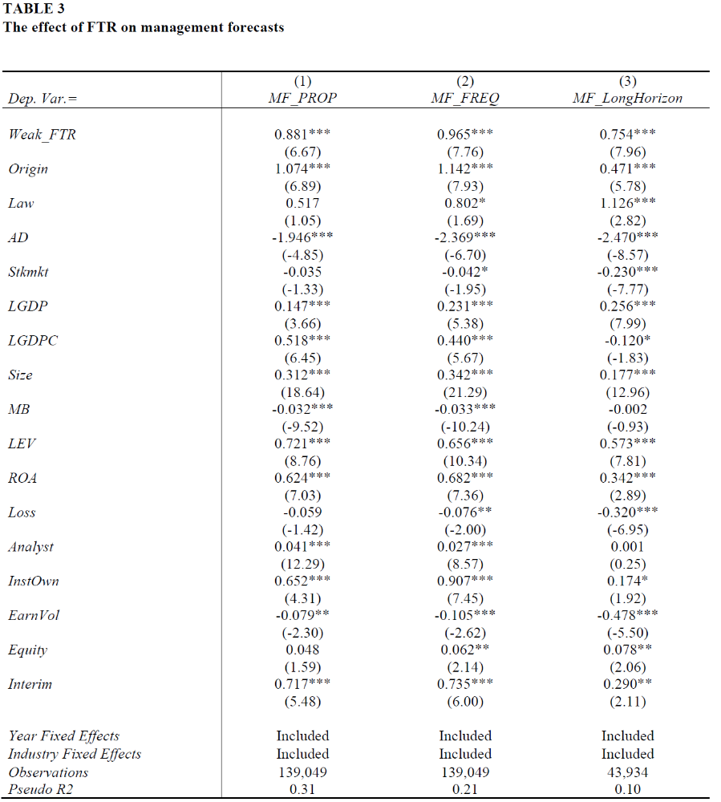

Slide 45
How to Mitigate ‘Omitted Variable’ Problem?
Language in one country may be highly correlated with some variables (observable or unobservable), which may also affect MF.
  For example, investor protection/stock market development/culture.
We perform three tests to mitigate this ‘omitted variable’ problem.
  Control for other country level cultural factors.
  Foreign institutional ownership (FIO) from weak-FTR countries
    In subsample of countries with strong FTR languages (no variations in country-level FTR)
    Firm-level difference in FTR arising from FIO can still explain MF.
  Firms cross-listed in Germany
    Firms from strong-FTR countries increase their MF, while firms from weak-FTR countries do not.

Slide 46
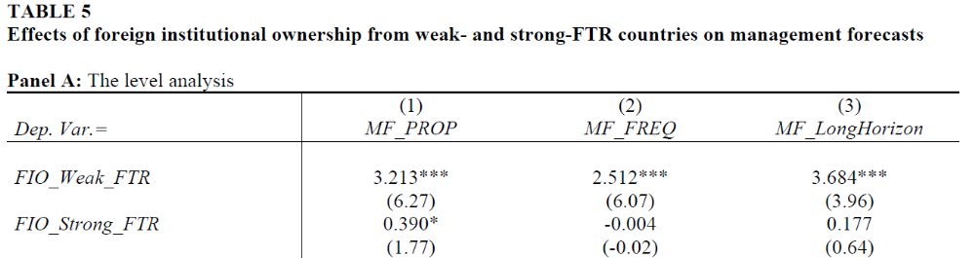
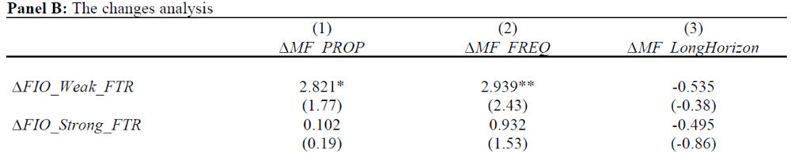

Slide 47
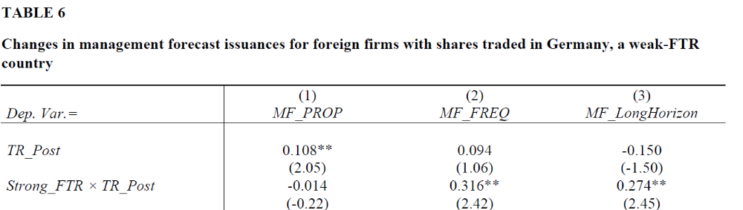

Slide 48
Robustness Tests
Robustness Tests
  Alternative measures of FTR
    “Verb_ratio” is the number of grammatically future-marked verbs divided by the total number of future-referring verbs.
    “Sentence_ratio” measures what share of sentences regarding future contains a grammatical future marker.
  Subsample analyses

Slide 49
Conclusions
We find robust evidence that firms in countries that speak weak-FTR languages issue more (long-horizon) management forecasts relative to firms in countries that speak strong-FTR languages.

Slide 50
Potential Contributions
First, we present the first evidence on how languages investors speak influence investors’ demand for forward-looking disclosure.
Second, we show empirical evidence on the determinant of management forecasts around the world.

Slide 51
Week 2 homework question: Proprietary cost of disclosure is often defined as the economic losses incurred when product market competitors exploit the disclosed information to the disadvantage of the disclosing firm. What other sources could give rise to the proprietary cost of disclosure?

